Slide 1

E&P Weekly Update
September 14th, 2015
Week 02
5 Weeks and 6 Days until PDR
James Pettit
Thomas Arrington
Travis Bates
Armando Gonzalez-Feuchter
Bradford Stricklin

Slide 2
Last Week
Went over responsibilities of E&P
Familiarized ourselves with new rules
Brainstormed payload ideas
Need clarification of rules for some ideas
Discussed possible joint D&O/E&P functions
Active stability or Air brakes,

Slide 3
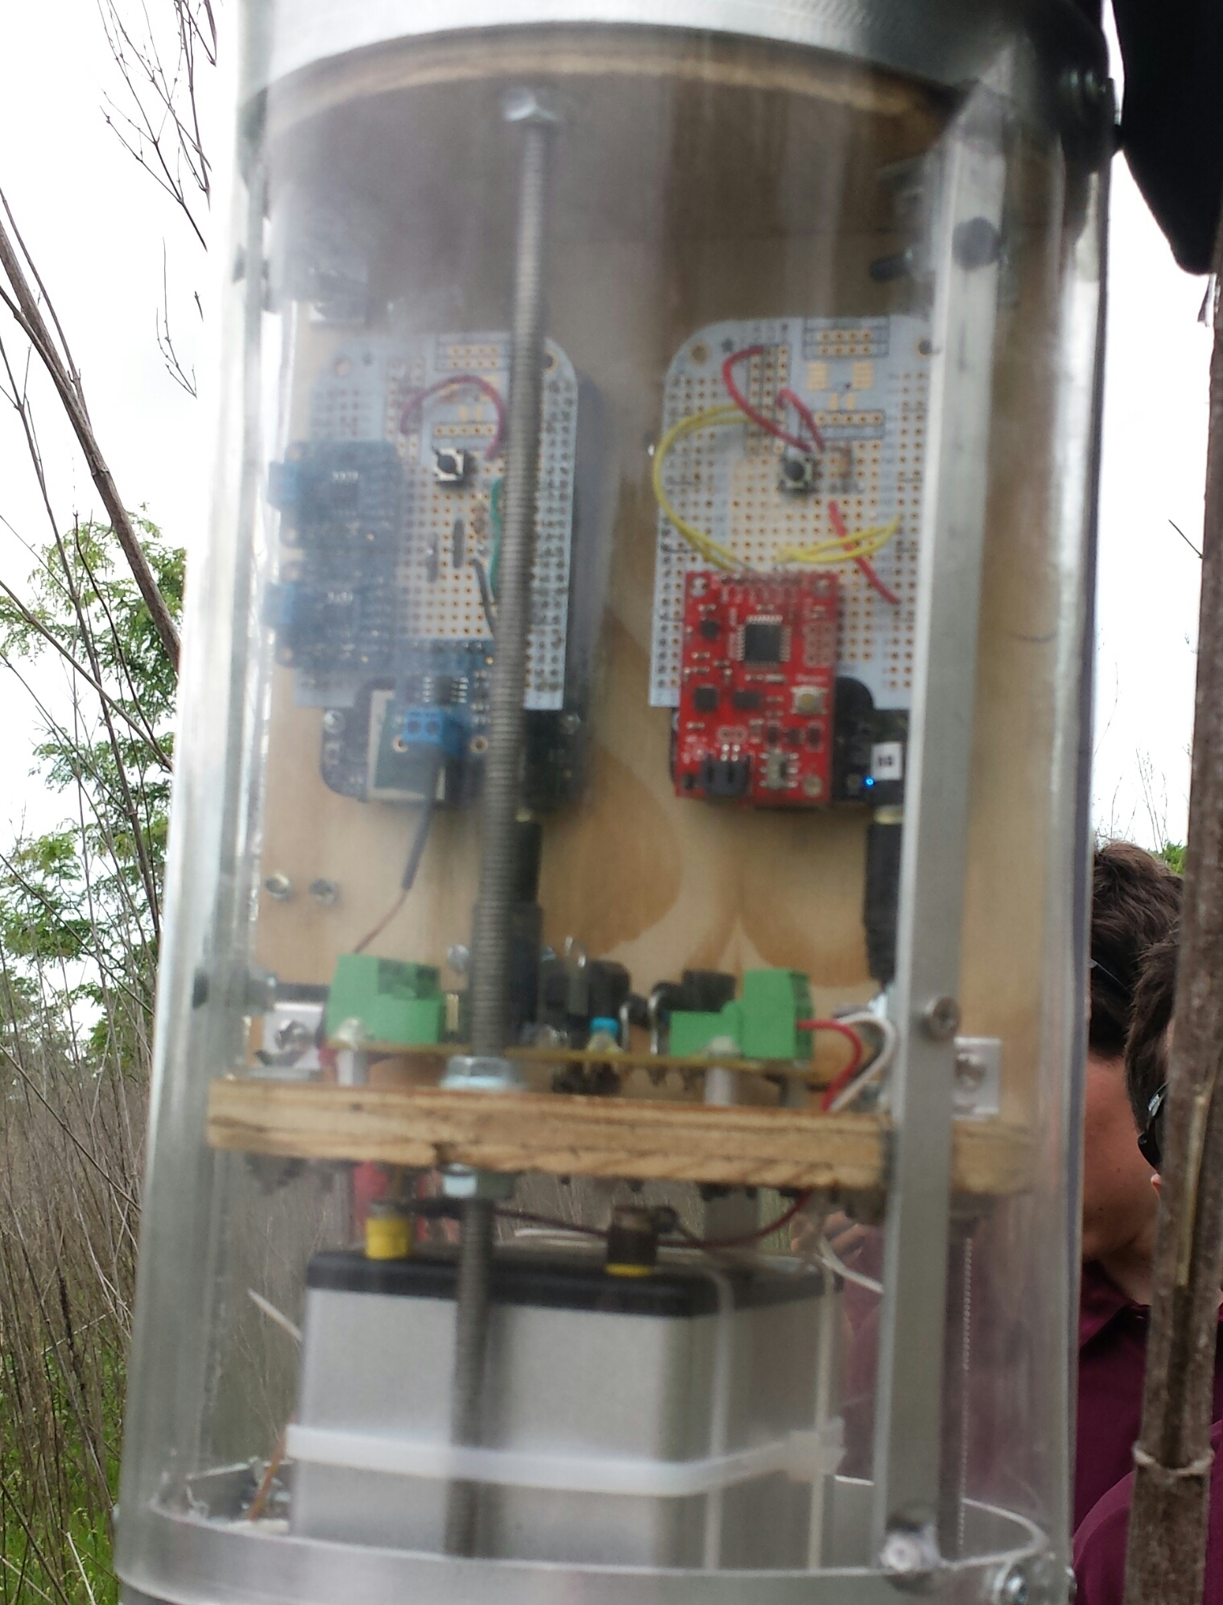
This Week
Select team roles and begin learning components and requirements
Narrow in on payload ideas
Begin familiarizing ourselves with the specific equipment we will be using

